Slide 1
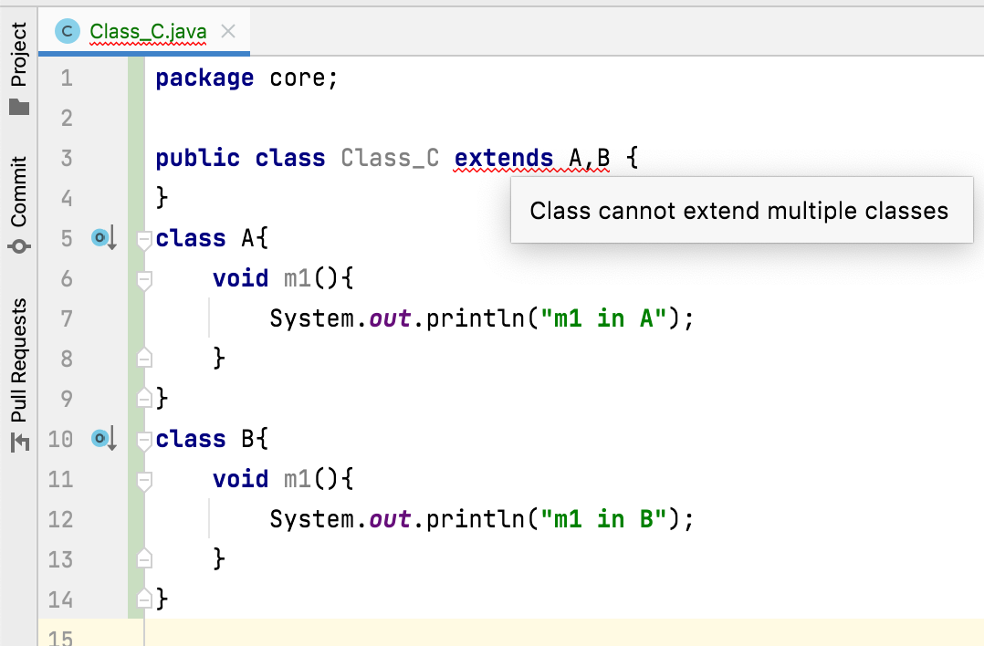
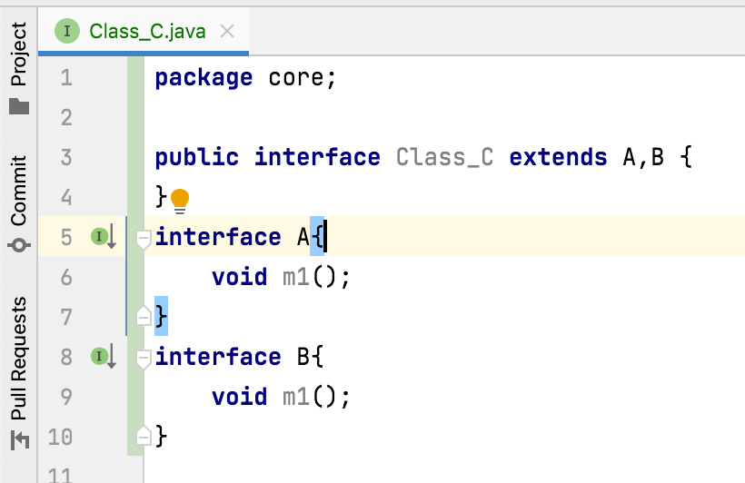
Does Java support multiple inheritance?
To avoid ambiguity and confusion, Java does not support.
i.e., a class can not extend more than one class.
For example,
if Class C extends Class A and Class B which have a method
with same name, then Class C will have two methods with same name.
This causes ambiguity and confusion for which method to use.
To avoid this, Java does not support multiple inheritance.

